Slide 1
INTRODUCTION TO JIRA
By- Sheeraz Zulfi

Slide 2
JIRA tutorial for beginners
The name "JIRA" is inherited from the Japanese word "Gojira" which means "Godzilla". JIRA is a project management tool used for issue tracking, bug tracking, and other project management purposes.

Slide 3
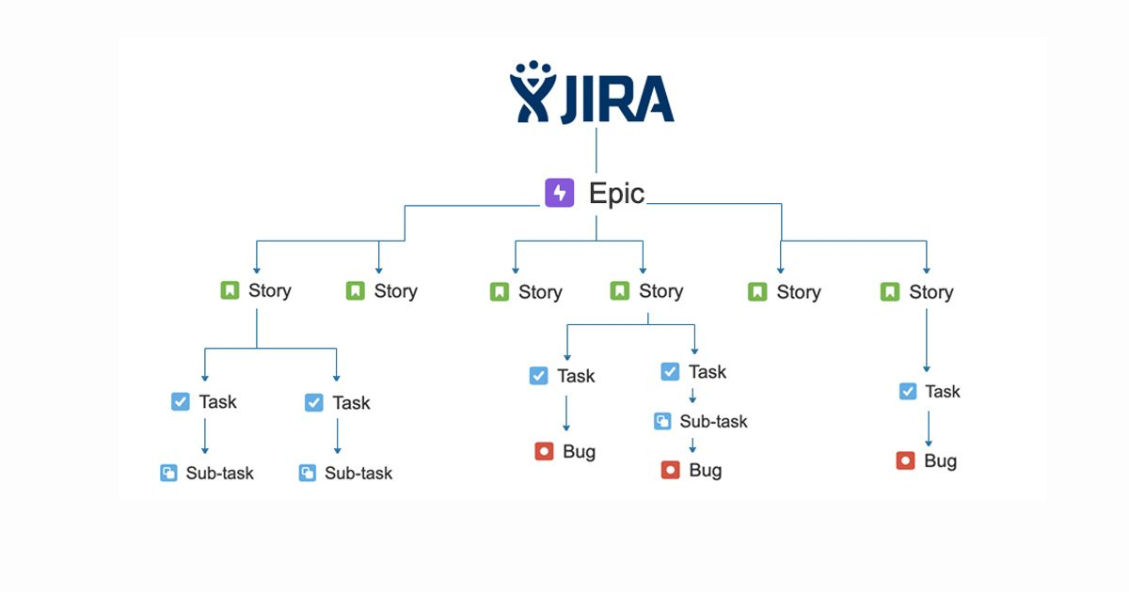
What is JIRA?
If we talk about its version then the current version which has been running these days is JIRA 6 and it is completely based on Agile Methodology. JIRA allows the developers to fix the bugs and make improvements via this tool.

Slide 4
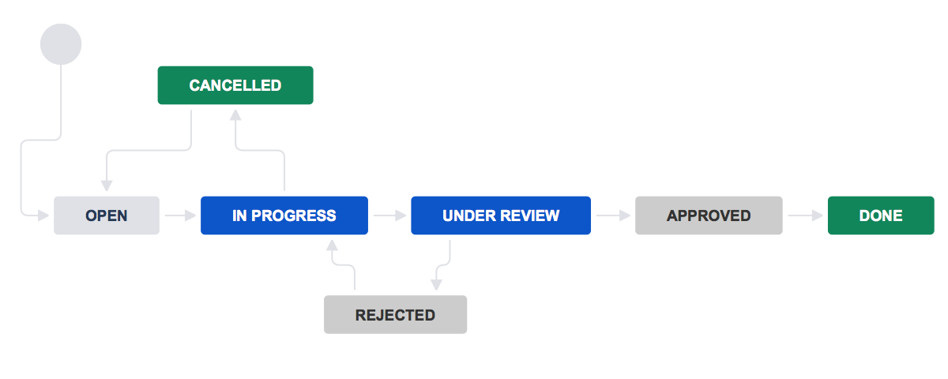
How JIRA works?
If we talk about the work process then it permits you to organize your tasks and other priorities. It gathers contextual data or information regarding your tasks from stories, tracks your project progress, report, and tackle all of your bugs, as well as release project versions all when you perceive fit.

Slide 5
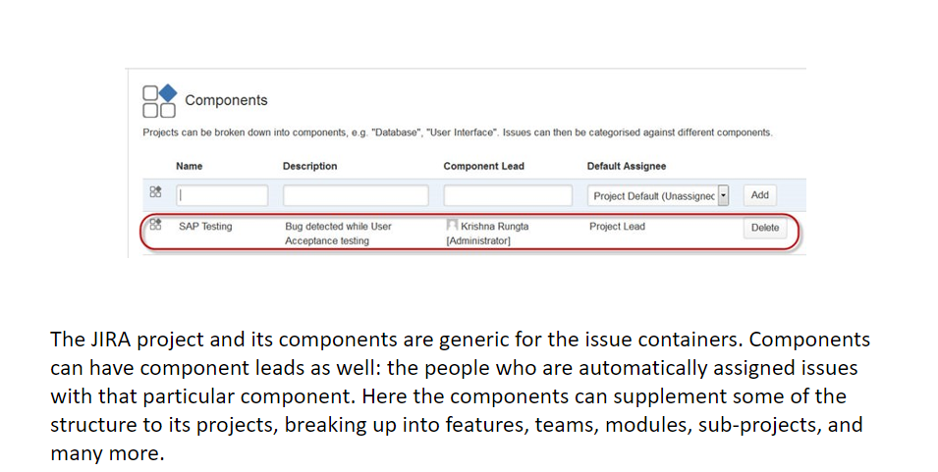
JIRA Components

Slide 6
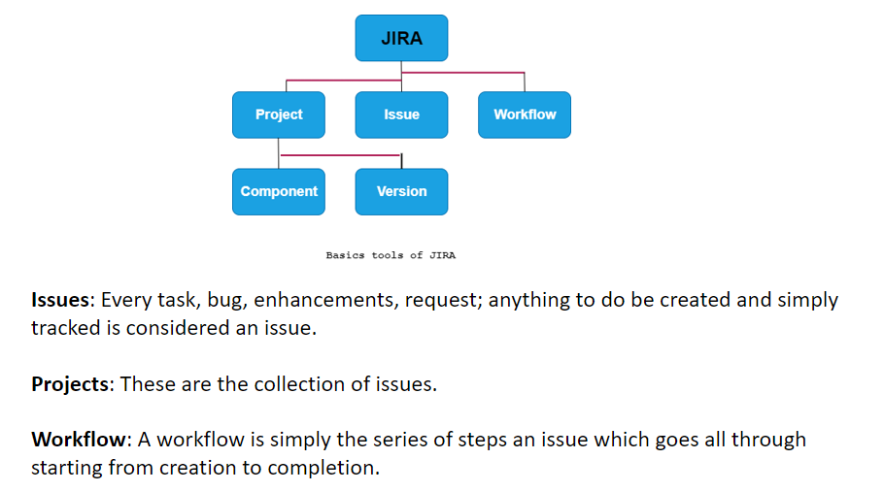
Basics of Jira Concepts

Slide 7
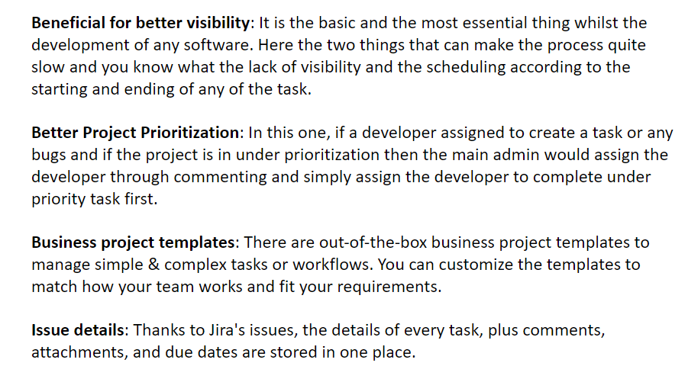
Features of Jira Softwares

Slide 8
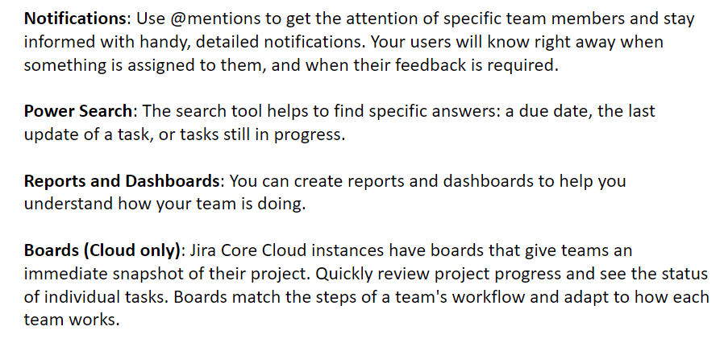
Conti..

Slide 9
THANK YOU

